Slide 1


Arduino based star tracker
Engineering Student Project Grant Scheme, CST-up
Guide:
Dr. Faiyaz ahmad
Associate professor, Integral University
Team:
Hozaifa shakeel (Team lead)
Insha yashfeen ansari
Faiz ahmad raza

Slide 2

ARDUINO BASED STAR TRACKER
“Arduino based star tracker” is an Arduino based, GoTo-mount inspired star tracking system. Based on the functionality of GoTo mounts.
It tracks any celestial object in the sky using Celestial coordinates as input.

Slide 3
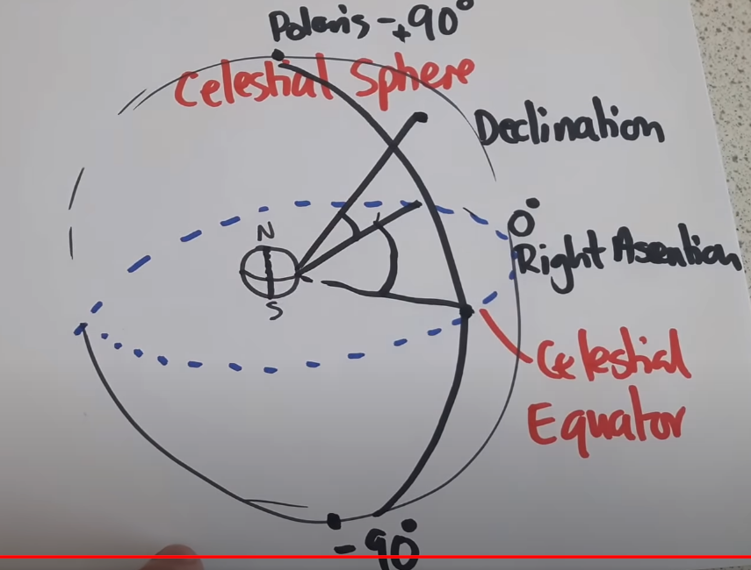
Equatorial COORDINATE System

Slide 4
Coordinates of equatorial system
Declination
The coordinate indicating where an object is between the celestial poles is declination. Measured from the celestial equator it ranges from 0° to 90° at the north celestial pole and to -90° at the south celestial pole.
Right Ascension
It is like (but not the same as) longitude.
It locates where a star is along the celestial equator. It has a zero reference point like green which, called the Vernal Equinox Point (we will get into locating that later).
Unlike Declination, Right Ascension changes with time

Slide 5
Tools & Parts
5V Stepper Motors: Precision motion control with 5V stepper motors for accurate and controlled rotation in your projects.
Arduino Uno R3 Clone: Open-source prototyping with an Arduino Uno R3 clone, unleashing the power of microcontrollers for endless creative possibilities.
3-Axis Gyro MPU6050: Enhance your projects with precise motion sensing using the 3-axis Gyro MPU6050, perfect for applications requiring orientation data.
SSD1306 OLED Display: The SSD1306 display is an OLED that is controlled by the SSD1306 micro-chip driver, which acts as a bridge between the display matrix and the microcontroller.
Laser Pointer: Add precision and visibility to your projects with a laser pointer, ideal for alignment, distance measurement, and creative light displays.
3D Printed Parts: Hardware of this project has been printed using “SNAPMAKER 2.0 MODULAR 3D PRINTER A350T.”

Slide 6
Logic
How Does it Work?
There are two Arduino's working in order. Arduino Uno being master and nano being the slave.
Master module
The master(Uno) module has two inputs,
Gyro data
RTC(Real Time Clock) data
and 6 outputs,
cw(base motor clockwise)
ccw(base motor counter clockwise)
stahp(base motor stop)
cw2(DEC motor clockwise)
ccw2(DEC motor counter clockwise)
stahp2(DEC motor stop)
The RTC is set to UTC time, a function calculates local sidereal time in degrees and rotates the mount to 0h RA position. The loop constantly checks if the gyro data is equal to the user input & sidereal time data. The default is 0,0. If there is a change and the equality breaks the master module send a command to the slave module.
If the user value is higher than the gyro value a signal is sent through cw the motor turns clockwise.
If the user value is less than the gyro value a signal is sent through ccw the motor turns counter clockwise
If the user value is equal to the gyro value a signal is sent through stahp and the motor stops, same for cw2,ccw2,stahp2.
This way the mount will turn to the user-specified coordinates. And update with sidereal time thus it will track the sky.

Slide 7
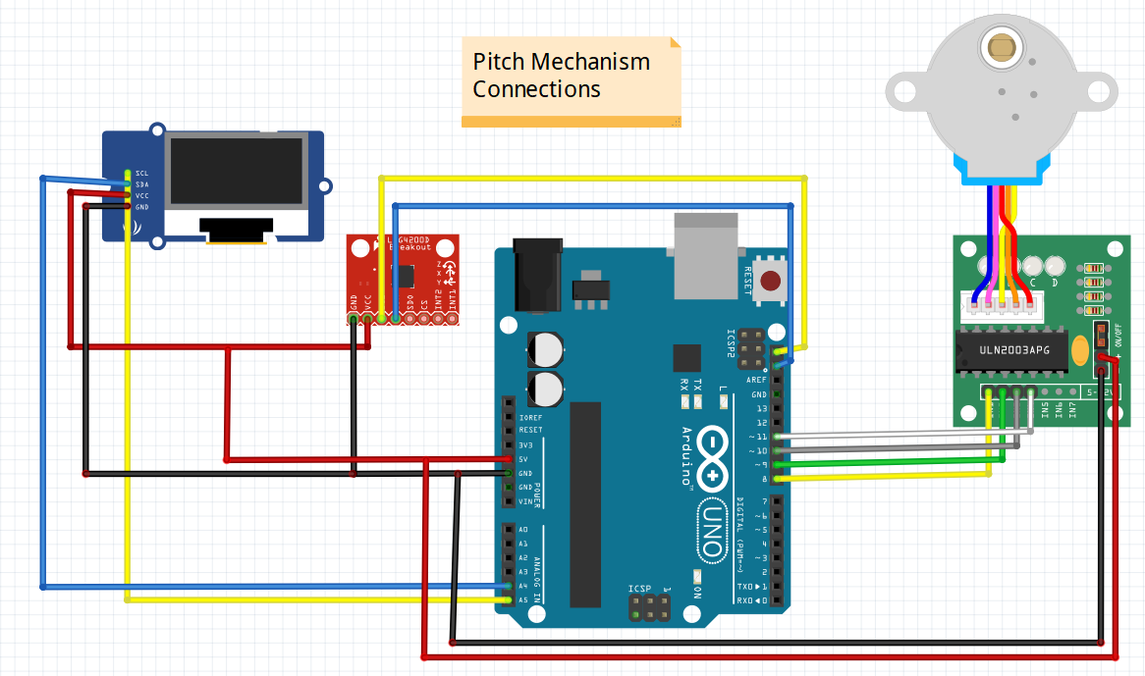
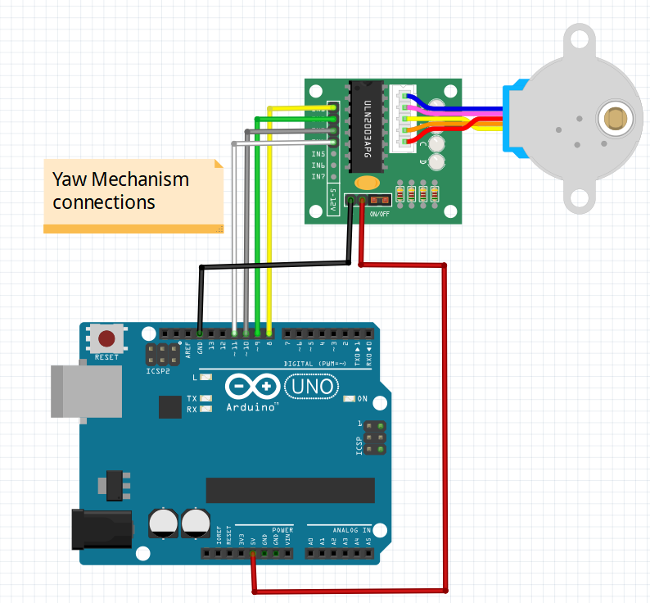
Parts and Wirings

Slide 8
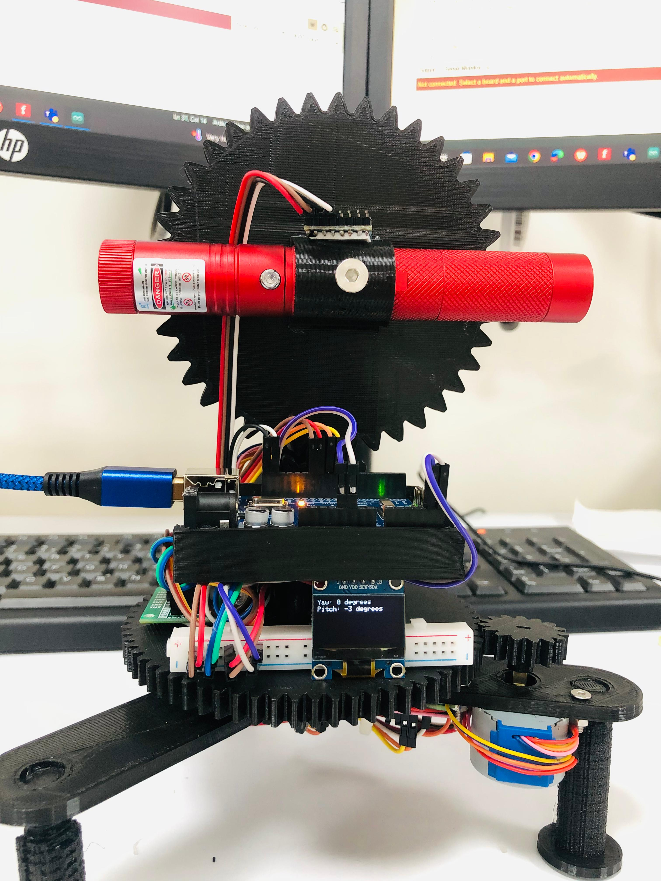
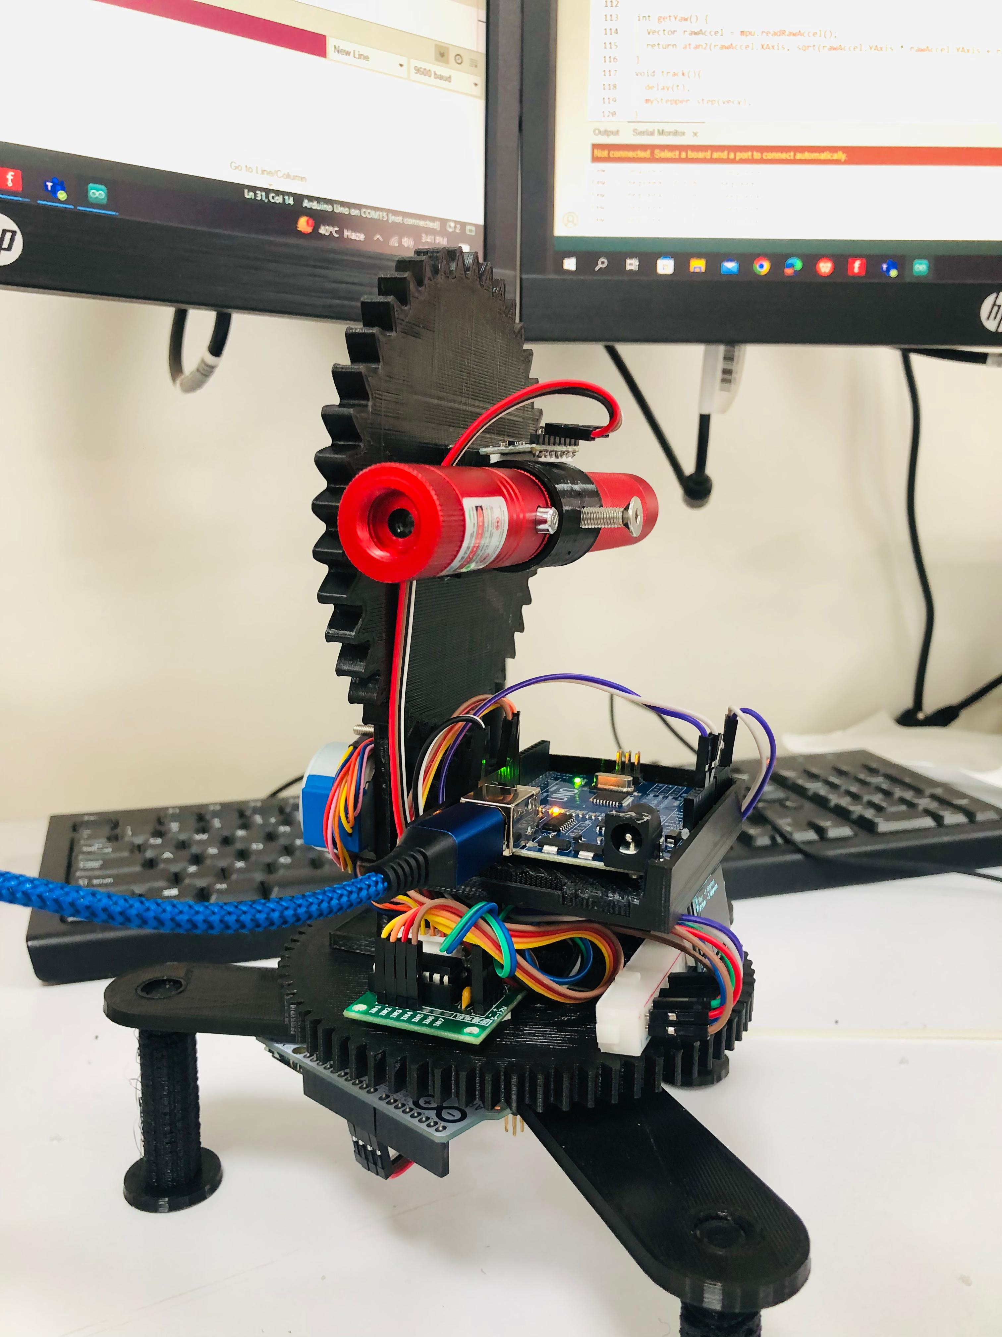
Assembled model

